Slide 1
Azure Event Grid

Slide 2
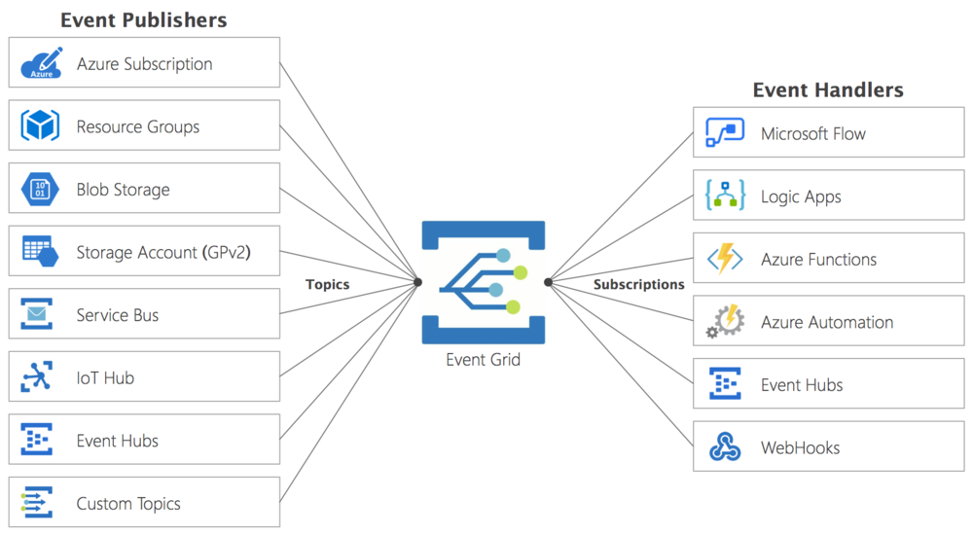
Event Grid

Slide 3
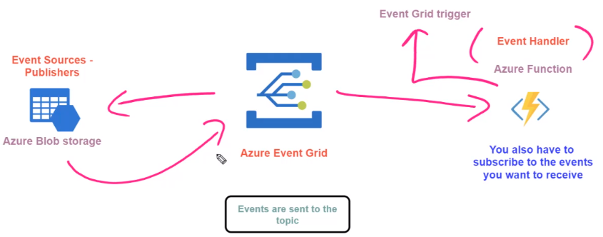
Azure Event Grid - Azure Function

Slide 4
Azure Event Grid - Azure Function
Create a storage account and container in it
Create a function app
Create a new function
Trigger -> Azure event grid trigger
Open function integration section
Open trigger details
Click -> Create Event Grid Subscription
Upload file in storage account container
Monitor the function logs

Slide 5


